Slide 1
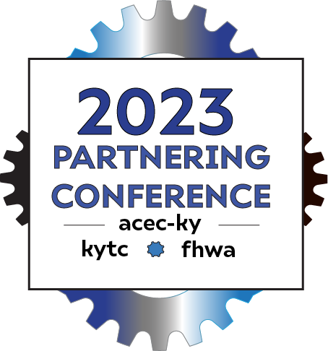
SPR 23-636
Accommodating Innovative Uses of Public Right of Way
David Moses, PE, PLS
Research Engineer
Kentucky Transportation Center
david.moses@uky.edu
Jennifer McCleve, PE
Utilities and Rail Branch Manager
Kentucky Transportation Cabinet
jennifer.mccleve@ky.gov
KENTUCKY TRANSPORTATION CENTER

Slide 2
Clean Energy and Connectivity (CEC) Uses
Renewable/Alternative Power
Solar
Wind
Broadband
Small Cell Wireless
Connected Autonomous Vehicle Equipment
Electric Vehicle Charging Stations
RESEARCH
ABSTRACT
DESIGN
KENTUCKY TRANSPORTATION CENTER

Slide 3
Study Focus
CEC Uses Along Highway
Facilities Owned By Others and Subject to KYTC Utility Accommodation Policy
Proposed KYTC Projects - Utilities Function within the Division of Right of Way and Utilities
Existing KYTC Roadways – Permits Function within the Division of Maintenance
RESEARCH
ABSTRACT
DESIGN
KENTUCKY TRANSPORTATION CENTER

Slide 4
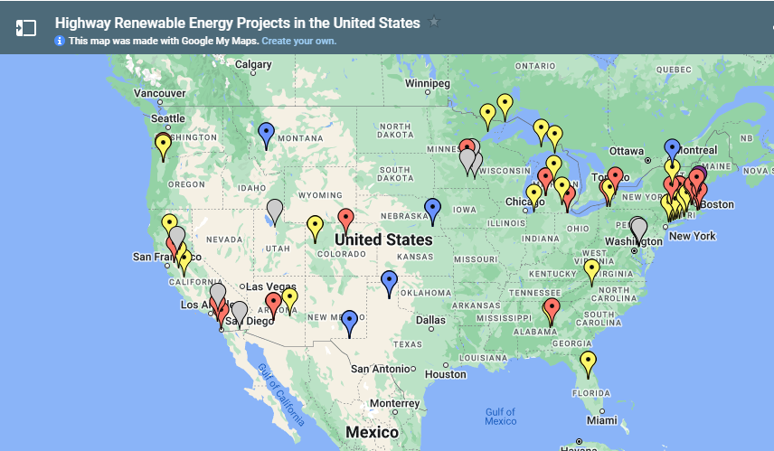
Clean Energy and Connectivity (CEC) Uses

Slide 5
States are using Solar and Wind Power to:
Power State Buildings (Maintenance Garage, Rest Areas, Welcome Centers)
Street/Parking Lot Lighting
Crosswalk Visibility
Weigh in Motion Systems
EV Charging
Road and Bridge Lighting
Radar Sensors
Roadway Signs
Pavement Markers
RESEARCH
ABSTRACT
DESIGN
KENTUCKY TRANSPORTATION CENTER

Slide 6
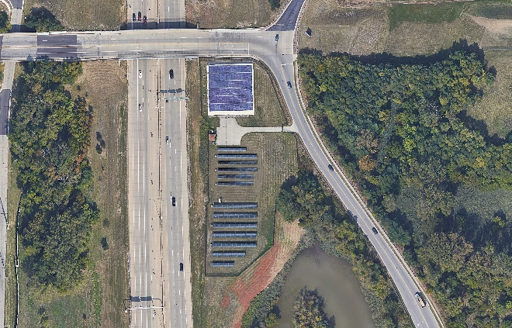
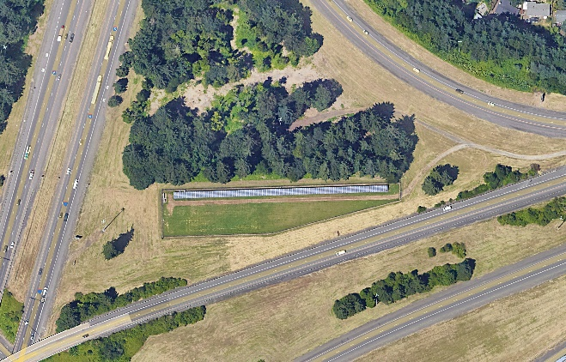
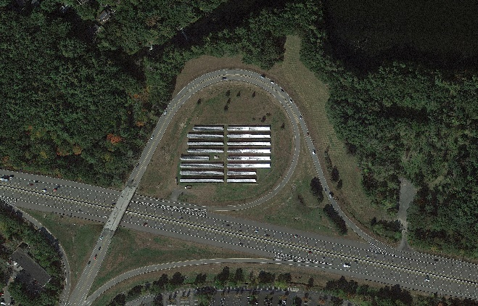
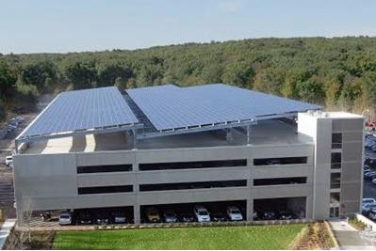
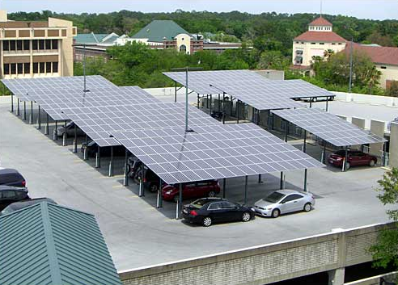
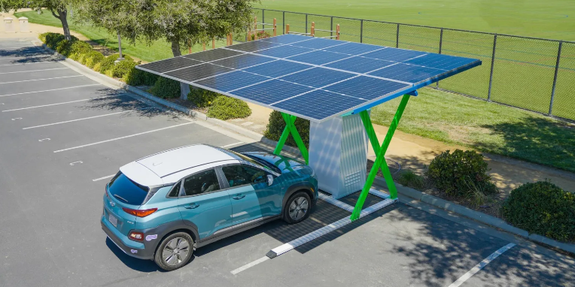
Specific Examples of DOT Uses of Solar
Within highway right of way
Interchange, roadway & bridge lighting
Signage
Rest areas
Roof mounted on building facilities
Canopies for parking areas and parking garages
Electric vehicle charging stations
Small equipment
Signs
Sensors
Markers
RESEARCH
ABSTRACT
DESIGN
https://electrek.co/2022/09/13/modular-solar-ev-charger/
KENTUCKY TRANSPORTATION CENTER
KENTUCKY TRANSPORTATION CENTER

Slide 7
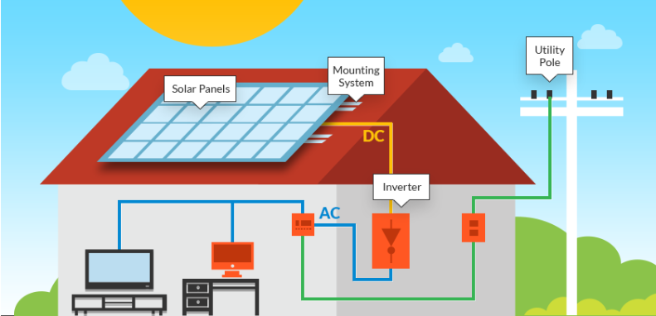
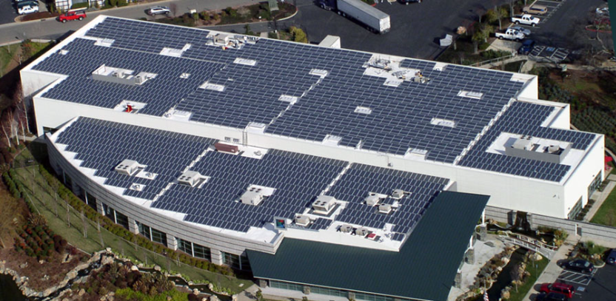
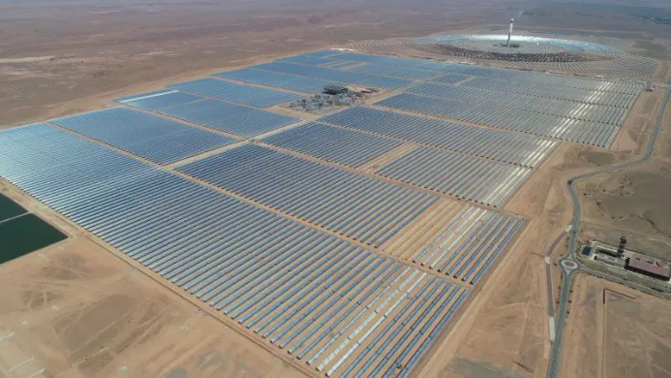
Types of Solar Installations
Three types of scaled systems
Residential
Roof mounted
Offset home energy use
Commercial and industrial
Similar but larger scale than residential systems
Roof mounted, parking lot canopies, open fields
Offset energy use and can be a revenue source
Utility
Very large scale
Sell electricity to utility companies or owned by them
RESEARCH
ABSTRACT
DESIGN
KENTUCKY TRANSPORTATION CENTER

Slide 8
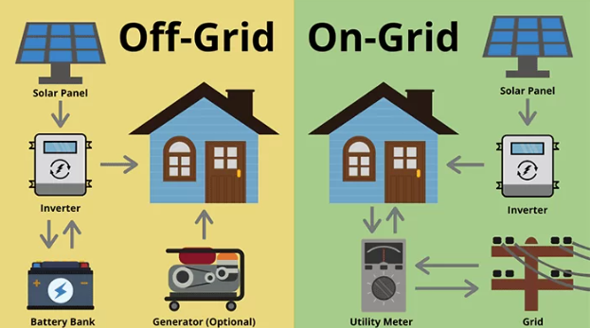
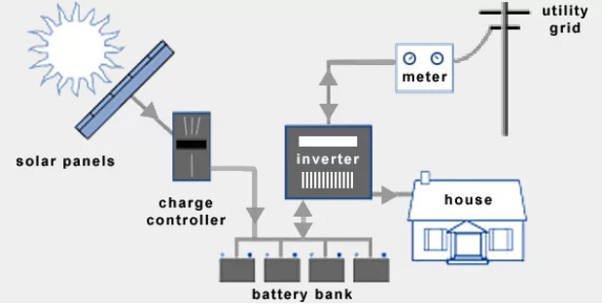
Types of Solar Installations
Three solutions
Grid-tied
Connected to existing power grid
Power supplied by grid during low energy production periods
Off-grid
Not connected to existing power grid
Reliability on solar production only
Battery system for storage for use during low energy production periods
Hybrid
Connected to existing power grid
Use battery system for storage
Most flexible – power can be provided by grid or battery during low energy production periods
RESEARCH
ABSTRACT
DESIGN
KENTUCKY TRANSPORTATION CENTER
KENTUCKY TRANSPORTATION CENTER

Slide 9
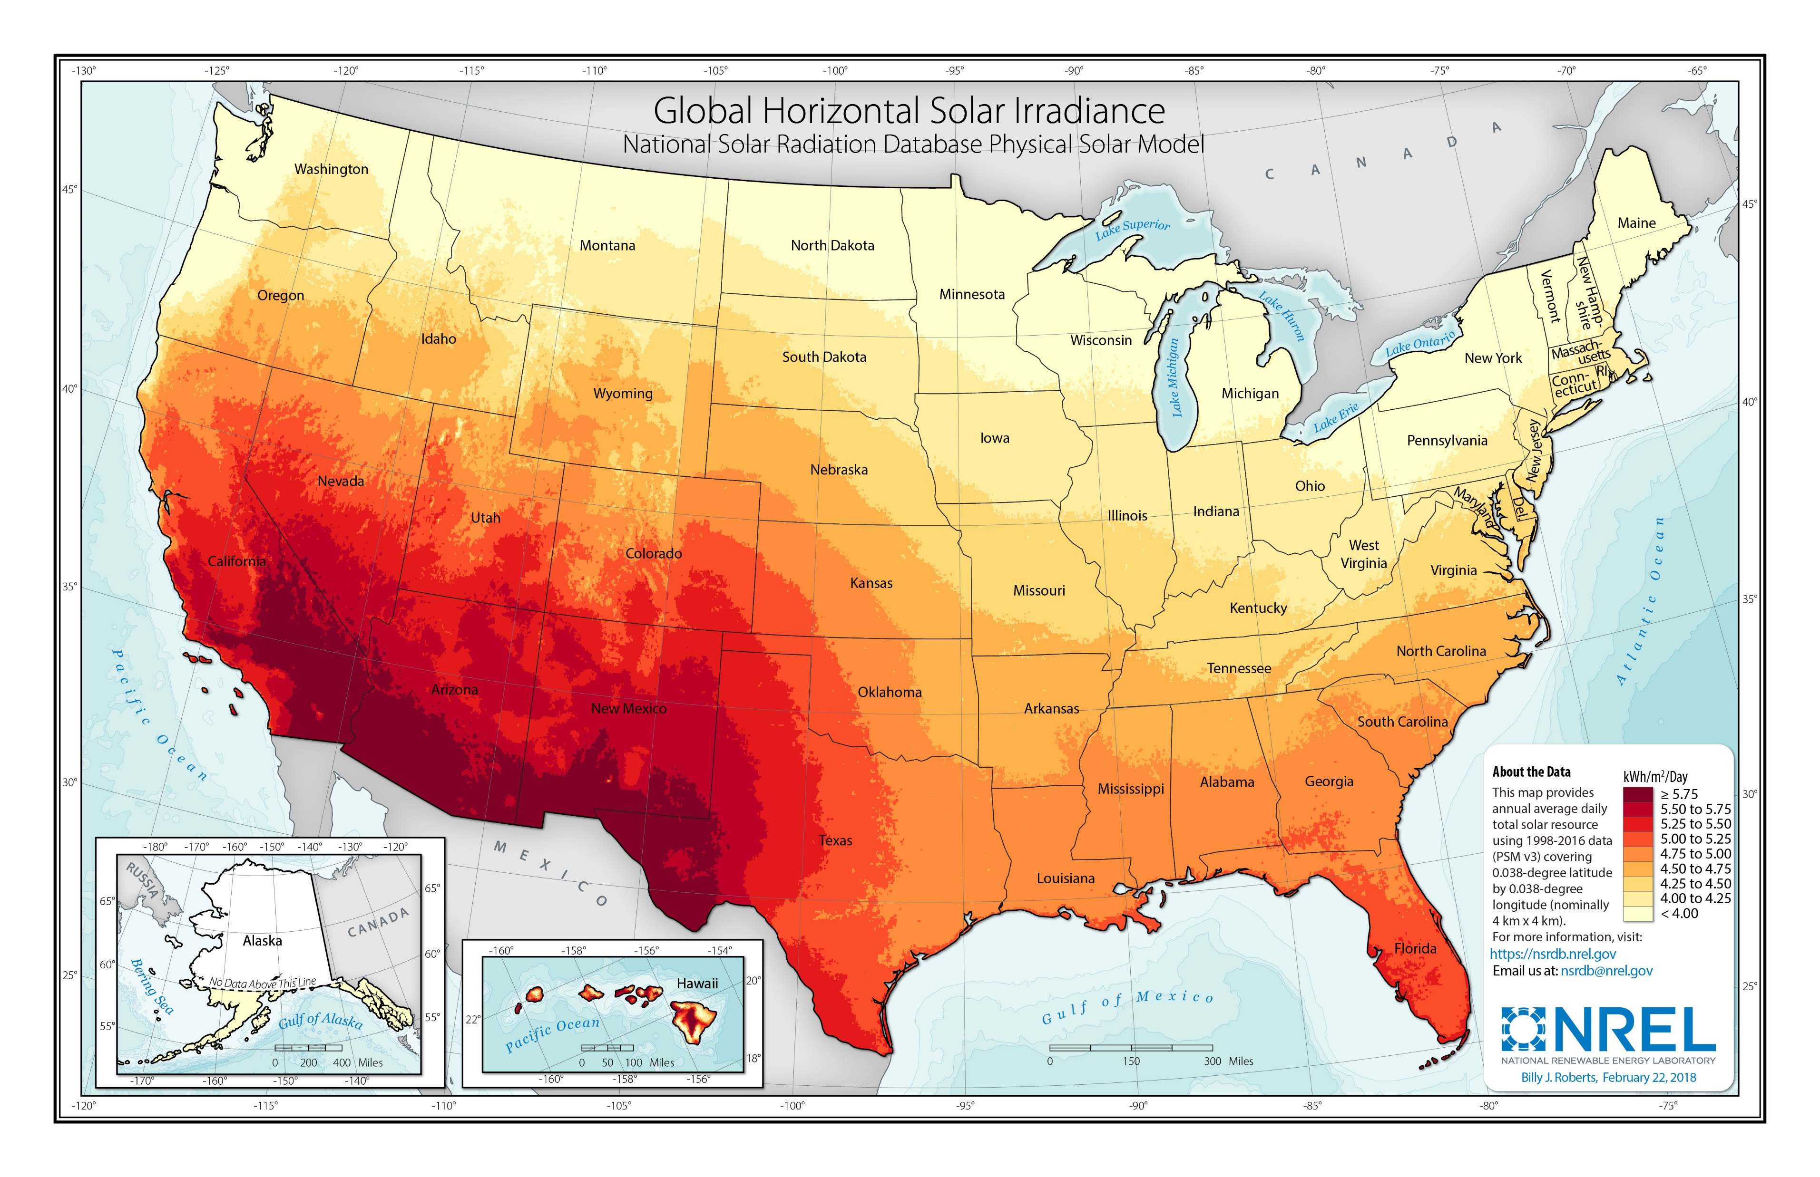
Types of Solar Installations
Equipment required
Solar photovoltaic (PV) panels
Convert solar energy to electricity
Inverter
Convert direct current (DC) electricity into alternating current (AC) electricity
Racking and mounting systems
Fixed or sun tracking
Monitoring system
Energy storage
Battery or grid tie
Charge controller
Regulates charging to battery
RESEARCH
ABSTRACT
DESIGN
KENTUCKY TRANSPORTATION CENTER
KENTUCKY TRANSPORTATION CENTER

Slide 10
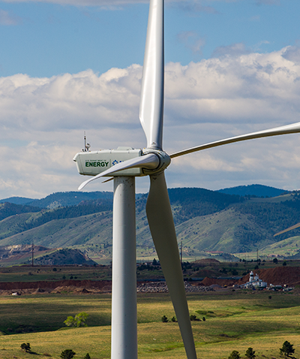
Wind Power
One wind turbine can generate the same amount of electricity as ~48,704 solar panels
Most facilities located in rural areas
Require a lot of land
Many consider turbines an eyesore and source of noise pollution
Can be dangerous to wildlife
Wind speeds can vary hour to hour and season to season affecting output
Three solutions
Utility-scale – 100kW to several MW to grid
Offshore – typically largest turbines and utility-scale generally
Distributed – less than 100kW
Supplement a home, farm, or business on grid
Provide power off grid
RESEARCH
ABSTRACT
DESIGN
KENTUCKY TRANSPORTATION CENTER
KENTUCKY TRANSPORTATION CENTER

Slide 11
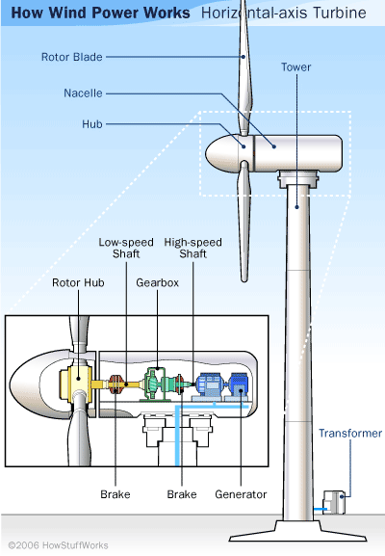
Wind Power
Equipment required
Tower
Supports turbine at heights up to 300 feet
Nacelle
Housing that contains components that convert wind energy to electricity
Hub
Attaches blades to nacelle and facilitates rotation
Blades
Typically three in an airfoil shape (horizontal)
Inverter
Converts DC electricity to AC
Storage
Battery or grid connection for net metering
RESEARCH
ABSTRACT
DESIGN
KENTUCKY TRANSPORTATION CENTER

Slide 12
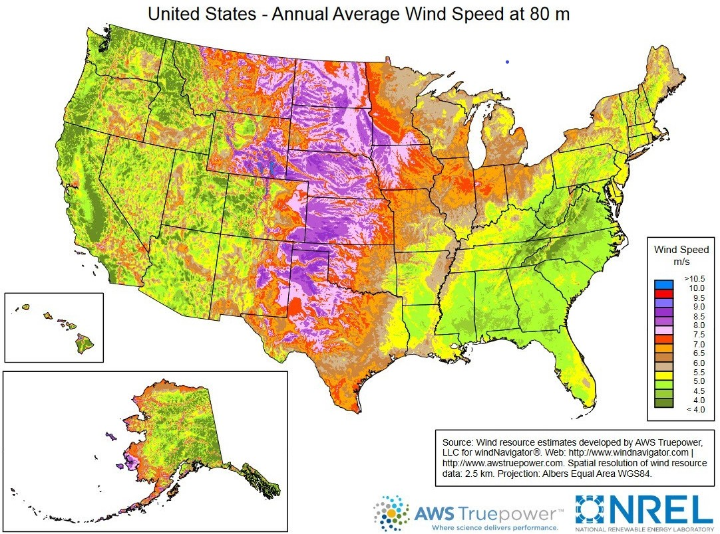
RESEARCH
ABSTRACT
DESIGN
KENTUCKY TRANSPORTATION CENTER

Slide 13
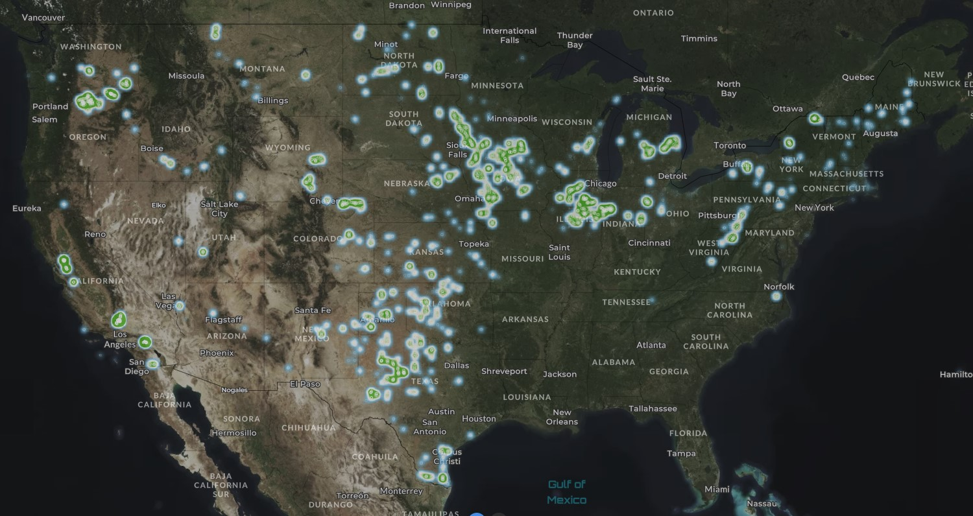
US Wind Turbine Database
KENTUCKY TRANSPORTATION CENTER

Slide 14
Broadband
Always-on high-speed internet access data transmitted through:
Digital subscriber line (DSL) – telephone lines
Cable – coaxial cable (television)
Fiber optic – pulses of light through flexible glass or tubing
Wireless – radio frequencies between a local receiver and a tower or other fixed device
Satellite – between an orbiting satellite and receiver
Mobile – mobile device such as a smartphone
Accommodation within right of way
Telephone, cable, and fiber optic – currently
Mobile – developing technology to be expanded upon with discussion of small cell wireless and C/AV
RESEARCH
ABSTRACT
DESIGN
KENTUCKY TRANSPORTATION CENTER

Slide 15
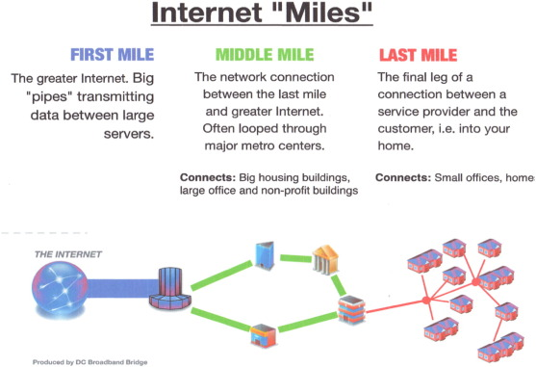
KENTUCKY TRANSPORTATION CENTER

Slide 16
Kentucky Broadband Efforts
Kentucky Wired
State-run project constructing over 3,000 miles of “middle mile” high-speed, high-capacity fiber optic cable
Connecting government offices, universities, community colleges, state police posts, state parks, and other government institutions
Kentucky Office of Broadband Development
Manage various state and federal funds for “last mile” broadband infrastructure projects
Private companies eligible for grants
KENTUCKY TRANSPORTATION CENTER

Slide 17
RESEARCH
ABSTRACT
DESIGN
KENTUCKY TRANSPORTATION CENTER

Slide 18
What is Small Cell Wireless
Small radio antennas that provide short-range wireless data transmission within small areas
Small cell facilities densify coverage when macrocell towers reach capacity
Requires little power
Equipment
Radio equipment and antenna
Require power, backhaul, and a permitted space
Can be constructed on streetlights, utility poles, sides of buildings, etc
RESEARCH
ABSTRACT
DESIGN
KENTUCKY TRANSPORTATION CENTER

Slide 19
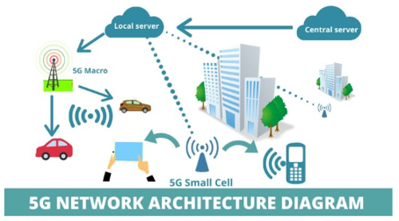
What is Small Cell Wireless
Mobile broadband and significant contributor to enabling 5G
Accommodates significantly higher data transfer rates than previous technology
Small Cell Range ~ 1.5 miles
Macrocell towers – what we are familiar with (range ~ 25 miles)
RESEARCH
ABSTRACT
DESIGN
Typically connected directly to fiber (backhaul)
Microwave transmission back to macrocell could be used for backhaul (rural areas)
Owners tend to be the three major wireless providers
SHE Memo dated June 18, 2017
KENTUCKY TRANSPORTATION CENTER

Slide 20
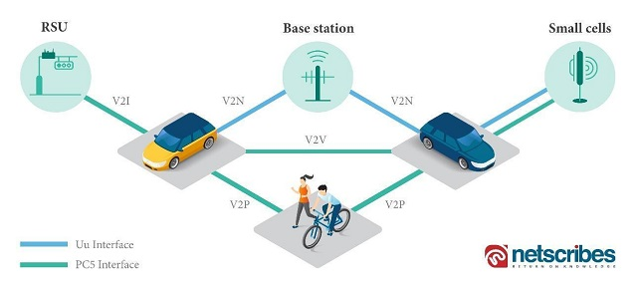
Connected and Autonomous Vehicles
C/AV Network Architecture
Connected vehicles – communicate with other vehicles or infrastructure
Autonomous vehicles – can operate without a human driver
For study focus on connected vehicles as autonomy results from connection
Vehicles are already equipped with some level of connection (Adaptive Cruise Control, Real Time Route Planning)
Connected vehicles communicate with other vehicles and infrastructure
GPS
Broadband wireless
Cellular networks
Future technology will need to accommodate thousands of connections simultaneously
V2I – Vehicle to infrastructure
V2N – Vehicle to network
V2V – Vehicle to vehicle
V2P – Vehicle to pedestrian
V2X – Vehicle to everything
RESEARCH
ABSTRACT
DESIGN
KENTUCKY TRANSPORTATION CENTER
KENTUCKY TRANSPORTATION CENTER

Slide 21
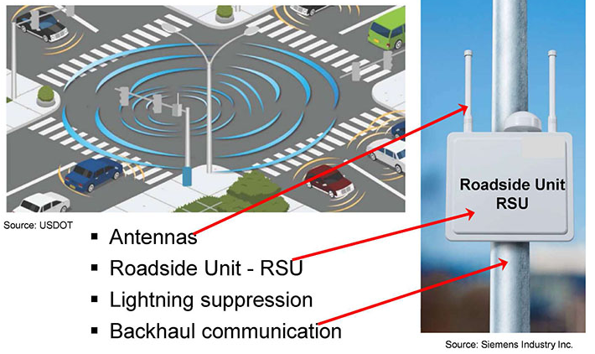
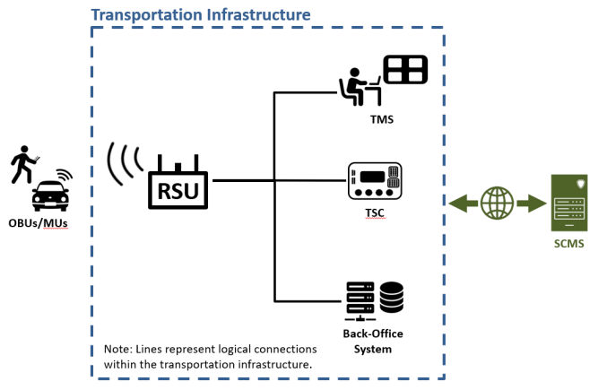
Connected and Automated
Vehicles
Equipment
OBUs – on board units
RSUs – roadside units
For this study, focus on roadside units
Similar in size to small cell units
Can be connected to infrastructure – signs, poles, etc.
Continuously evolving
USDOT has published report for standardizing roadside units
RESEARCH
ABSTRACT
DESIGN
KENTUCKY TRANSPORTATION CENTER
KENTUCKY TRANSPORTATION CENTER

Slide 22
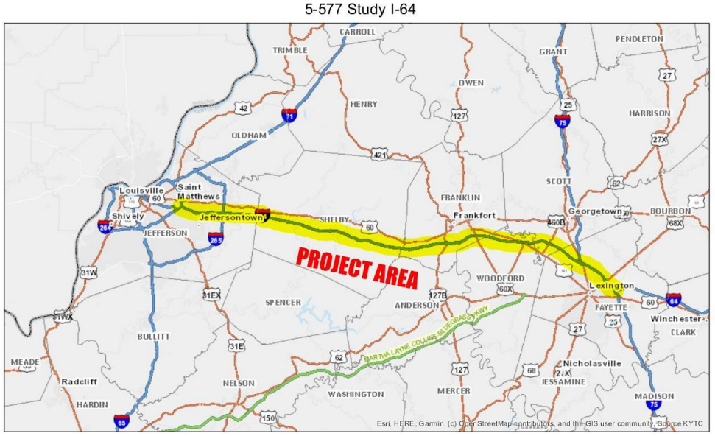
KYTC Item No. 5-577
Managed by Division of Planning
Goals and objectives
Evaluate Feasibility of dedicated C/AV lanes or other configurations on I-64 between Louisville and Lexington
Suitability of the corridor to C/AV operations
Upgrades needed to implement those operations
Scope Items
Identify legal and regulatory hurdles and potential enabling legislation
Assess potential impacts to traffic
Identify and plan improvements to the corridor
Provide cost estimates and identify potential funding strategies
Intentionally engage stakeholders
Scope of work
Analyze infrastructure needs
System: digital and operational (hardware/software/edge computing)
Roadway: widening/striping/signage
Utilities: communication/broadband/power/ conduit
Identify and consider maintenance operations
RESEARCH
ABSTRACT
DESIGN
KENTUCKY TRANSPORTATION CENTER
KENTUCKY TRANSPORTATION CENTER

Slide 23
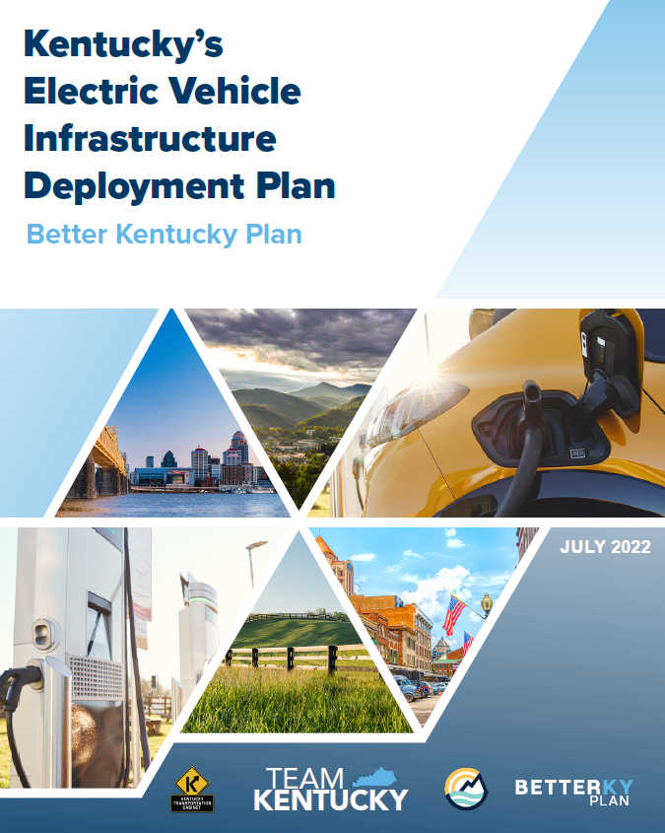
EV Charging Stations
KY's Electric Vehicle Charging Program is well underway
Round 1 RFP Proposal due date: August 24, 2023
Selected Developers will be responsible for: site acquisition, design, purchase, construction, installation of hardware and software, operation and maintenance (O&M), and reporting services for a given Project
KYTC will not own the sites
Sites cannot be on KYTC right of way
Follow this effort and learn from their experiences
RESEARCH
ABSTRACT
DESIGN
KENTUCKY TRANSPORTATION CENTER
KENTUCKY TRANSPORTATION CENTER

Slide 24
EV RFP
Corridor
Group
Map
RESEARCH
ABSTRACT
DESIGN
KENTUCKY TRANSPORTATION CENTER
KENTUCKY TRANSPORTATION CENTER

Slide 25
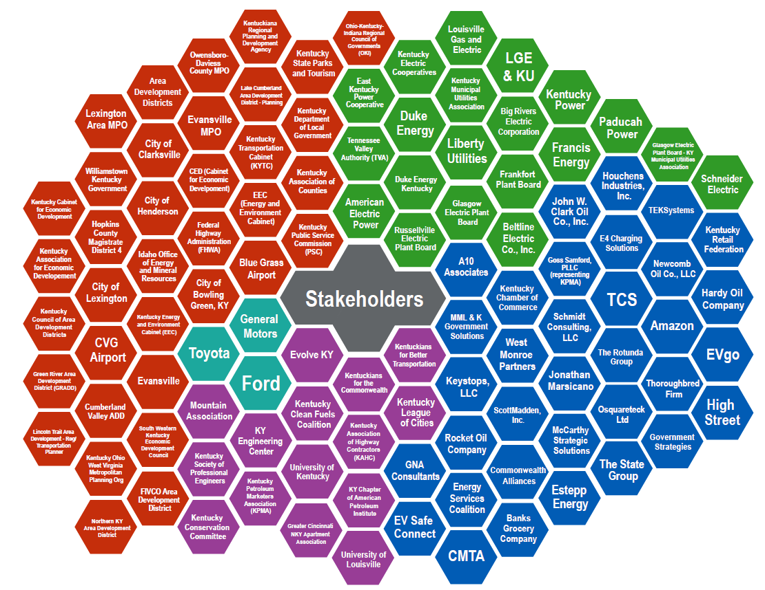
EV
Stakeholder Engagement
RESEARCH
ABSTRACT
DESIGN
KENTUCKY TRANSPORTATION CENTER
KENTUCKY TRANSPORTATION CENTER

Slide 26
Kentucky EV Website
https://kyevcharging.com
Contact Information
EVChargingProgram@ky.gov
RESEARCH
ABSTRACT
DESIGN
KENTUCKY TRANSPORTATION CENTER
KENTUCKY TRANSPORTATION CENTER

Slide 27
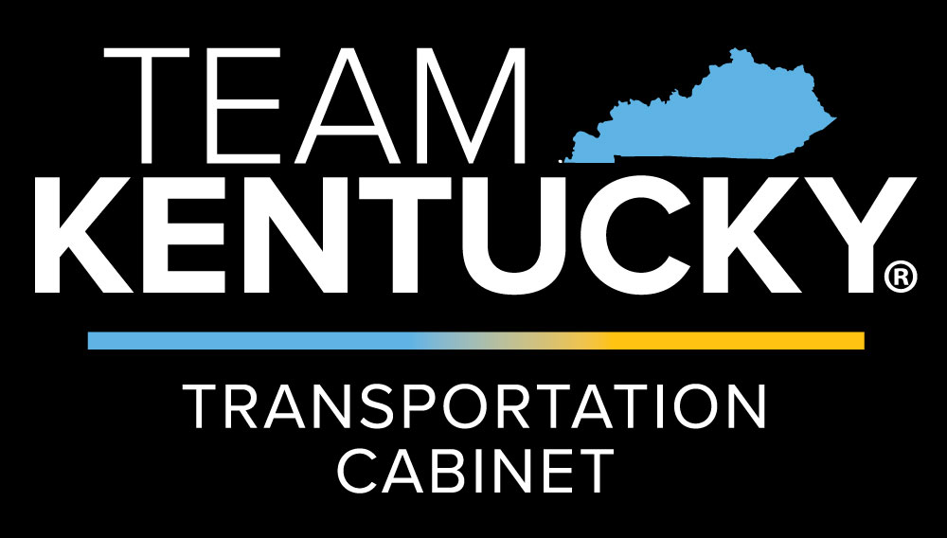
Current Regulatory Framework and Challenges
Federal Accommodation Options
State Definition of Utilities
Mobile Now Act
Ownership and Agreements
Regulatory Challenges
Private Involvement
KENTUCKY TRANSPORTATION CENTER

Slide 28
Two Methods To Accommodate CEC Uses Under Federal Regulation
Utility – 23 CFR part 645
State DOT Utility Accommodation Policy governs
FHWA approved UAP programmatically
Approvals required for changes in access on federal aid highways
Fees charged at the state’s discretion
Safety and operation cannot be impacted
Alternative Use of Right-of-Way – 23 CFR part 710
FHWA requires a public interest finding
Required for each individual use
Approvals required for changes in access on federal aid highways
Fair market rent usually required, FHWA has determined CEC excepted
Safety and operations cannot be Impacted
RESEARCH
ABSTRACT
DESIGN
KENTUCKY TRANSPORTATION CENTER
KENTUCKY TRANSPORTATION CENTER

Slide 29
Definition of a Utility under KRS 278.010
Any natural persons, partnerships, corporations, and two (2) or more persons having a joint or common interest…who owns, controls, operates, or manages any facility used or to be used for or in connection with:
(a) The generation, production, transmission, or distribution of electricity to or for the public, for compensation, for lights, heat, power, or other uses
(b) The production, manufacture, storage, distribution, sale, or furnishing of natural or manufactured gas, or a mixture of same, to or for the public, for compensation, for light, heat, power, or other uses
(c) The transporting or conveying of gas, crude oil, or other fluid substance by pipeline to or for the public, for compensation
(d) The diverting, developing, pumping, impounding, distributing, or furnishing of water to or for the public, for compensation
(e) The transmission or conveyance over wire, in air, or otherwise, of any message by telephone or telegraph for the public, for compensation
(f) The collection, transmission, or treatment of sewage for the public, for compensation, if the facility is a subdivision collection, transmission, or treatment facility plant that is affixed to real property and is located in a county containing a city of the first class or is a sewage collection, transmission, or treatment facility that is affixed to real property, that is located in any other county, and that is not subject to regulation by a metropolitan sewer district or any sanitation district created pursuant to KRS Chapter 220

Slide 30
Mobile Now Act
Signed into law on March 23, 2018
Prescribes additional requirements to facilitate the installation of broadband
State DOT must:
Identify a broadband utility coordinator
Include broadband in the utility process
Not a mandate to allow broadband in right of way
RESEARCH
ABSTRACT
DESIGN
KENTUCKY TRANSPORTATION CENTER

Slide 31
Private Involvement
Benefits
KYTC does not have the expertise to operate and maintain most of the equipment and systems required for these uses
Upfront costs can be mitigated by having private companies handle the construction
Drawbacks
May have conflicting interests with KYTC in terms of how they treat our right-of-way
RESEARCH
ABSTRACT
DESIGN
KENTUCKY TRANSPORTATION CENTER

Slide 32
Ownership and Development Models for
Renewable Energy Projects
Self Ownership
Public-Private Partnership (P3):
Third Party PPA
Solar Lease/License Revenue
Morris Model
Traditional Power Purchase Agreement (PPA)
RESEARCH
ABSTRACT
DESIGN
KENTUCKY TRANSPORTATION CENTER
Notes:
Third Party PPA - private entity to design, build, finance, operate, and maintain (or any combination thereof) a solar project, with little to no upfront capital investment required by KYTC
Solar Lease / License Revenue (P3). KYTC would lease unused land within the right of-way to a private developer, who would develop a solar project and make set land lease payments to KYTC
Morris Model (P3) hybrid PPA and bond issuance model, a private developer would design, build, operate, and maintain (or any combination thereof) a project, with Caltrans and the Department of Treasury providing
low-rate financing.
Utility Contract - KYTC would have a standard PPA contract with a local utility with set rates and terms

Slide 33
Regulatory Challenges
23 USC 11
Prohibits commercial activity within the Interstate ROW from serving motor vehicle users
Limits commercial activities in rest areas for serving motor vehicle users. Limited activities that are allowed in rest areas include:
Certain advertising and displays related to tourism, historical events, travel related information
Vending machines with preferences given to vendors operating under the Randolph-Sheppard Act
Any revenue must be used to maintain rest areas
Legality of PPA’s in Kentucky
RESEARCH
ABSTRACT
DESIGN
KENTUCKY TRANSPORTATION CENTER

Slide 34
Study Tasks
Task | Description | Status
1 | Review literature and transportation agency guidance on innovative uses of public ROW. | ✓
2 | Identify issues with current regulatory framework and recommend changes to legislation that would be necessary. | ✓
3 | Assess requirements for CEC applications on public ROW (e.g., electrical, land area, topography, special hardware, roadway modifications, clear zones). | ✓
4 | Establish material and locational standards for developing CEC facilities. Evaluate costs associated with each facility type.
5 | Identify general areas and/or corridors within the public ROW suitable for each CEC application.
6 | Prepare a technical brief and implementation plan, which describes how KYTC can accommodate innovative uses of its ROW
RESEARCH
ABSTRACT
DESIGN
KENTUCKY TRANSPORTATION CENTER

Slide 35
Possible Opportunities
Rest Areas – Renewables
Interchanges - Renewables
Park & Rides – Renewables, Charging Stations
Abandoned Utility Corridors - Broadband
Excess Right of Way – Broadband, Renewables
Existing Lighting Infrastructure and Utility Poles – Small Cell Wireless & CAV
RESEARCH
KENTUCKY TRANSPORTATION CENTER
KENTUCKY TRANSPORTATION CENTER

Slide 36
Thank You !
RESEARCH
David Moses, PE, PLS
Research Engineer
Kentucky Transportation Center
david.moses@uky.edu
Jennifer McCleve, PE
Utilities and Rail Branch Manager
Kentucky Transportation Cabinet
jennifer.mccleve@ky.gov
KENTUCKY TRANSPORTATION CENTER
KENTUCKY TRANSPORTATION CENTER

